Slide 1

NEVADA – OPEN MEETING LAW
Alexa Ravencroft
Deputy Attorney General
Nevada Attorney General’s Office
Nevada Revised Statutes Chapter241; Nevada Administrative Code Chapter 241

Slide 2
 | 1 |  |  |  | 2 |  |  |  |  | 3 |  |  |  | 4 |  |  |  |  | 5
What is the Open Meeting Law? |  |  |  | When does the OML apply? |  |  |  |  | How do I comply with the OML? |  |  |  | What happens when the OML is violated? |  |  |  |  | Updates from the 2025 Legislative Session
2

Slide 3

What is the Open Meeting Law (OML)?
NRS Chapter 241
“In enacting this chapter, the Legislature finds and declares that all public bodies exist to aid in the conduct of the people’s business. It is the intent of the law that their actions be taken openly and that their deliberations be conducted openly.” NRS 241.010(1).

Slide 4
When does the OML apply?
PUBLIC BODY
The OML generally applies to all meetings of public bodies in the State of Nevada.
  Includes subcommittees
  Exceptions are strictly construed
MEETING
Under the OML, a “meeting” requires a
Quorum + Deliberation or Action
Quorum means a simply majority of the total body
or other proportion established by law.
NRS 383.500 – a quorum of the CCCHP is 4 members
Deliberate means collectively to examine, weigh and reflect upon the reasons for or against an action.
Action means a majority vote of the members
present (all members for elected bodies).
4

Slide 5
When does the OML apply?
A gathering of a quorum at a social function or for training is not a meeting as long as there is no
deliberation or action.
Exception:Attorney client conference regarding potential or existing litigation, can include deliberation
          2025 update: can include legal advice as well
Electronic communication between a quorum of members can constitute a meeting.
  Email pitfall: “reply all”
Serial communications or “walking quorums” constitute a constructive meeting.
  A constructive quorum can exist with less than a quorum speaking together at any given time if opinions are relayed between members.
5

Slide 6

How do I comply with the OML?
6

Slide 7
Meeting Notice and Agenda
Must include:
  Time, place and location (or information on remote technology system)
  Name, contact and business address for supporting material, plus location (physical or electronic)
  Clear and complete statements of topics
  Action items denoted as “for possible action”
  Public comment periods and restrictions
Requirements can be found in NRS 241.020
Agenda posting requirements:
  Office of the public body or location of meeting
  Public body website
  Nevada notice website
Posted no later than 9 AM of the 3rd working
day before the meeting.
Notice must be sent to persons who have requested notice of meetings.
7

Slide 8
Additional Requirements
Minutes must be kept in conformance with
NRS 241.035.
Supporting material is required to be available to the public at the time it is provided to members of the public body.
An emergency meeting may only be called where the need to act upon a matter is truly unforeseen and circumstances dictate that immediate action is required.
Public bodies shall make reasonable efforts to assist and accommodate persons with physical disabilities desiring to attend.
Additional notice required for consideration of a person’s character, misconduct or competence or to take administrative action against a person.
Meetings must be recorded or transcribed.
8

Slide 9

Public Comment
Minimum requirement:
  Two options—general or limited to agenda items prior to any action item or on each action item after discussion, but prior to vote
  General public comment period at some time prior to adjournment
Restrictions must be reasonable time, place, and manner restrictions. NRS 241.020(3)(d)(3)
The OML does not “[p]revent the removal of any person who willfully
disrupts a meeting to the extent that its orderly conduct is made
impractical.”
New in 2025: remote public comment is only required when there is no physical location available to the public
9

Slide 10
How do I comply with the OML?
CLOSED SESSIONS
Closed sessions may be held by a public body to consider the character, alleged misconduct, professional competence or physical or mental health of a person. NRS 241.030
  May also be held to grade examinations.
Exceptions:
  Appointment of a member to the public body
  Consider the chief officer of the body/agency
Action must still occur during a public meeting.
VIRTUAL ATTENDANCE
Members of public bodies may attend virtually so long as a physical location for public to attend and provide public comment is provided..
Public must be able to hear and observe to the same level as members.
  Pit-fall: chat function in remote technology system.
10

Slide 11

What happens when the OML is violated?
Actions taken in violation of the OML are void.
Attorney General’s Office has authority to investigate and
prosecute violations.
Corrective action is recommended and while it may not eliminate the violation, it can mitigate severity and further ensure that the business of government is accomplished in the open.
11

Slide 12
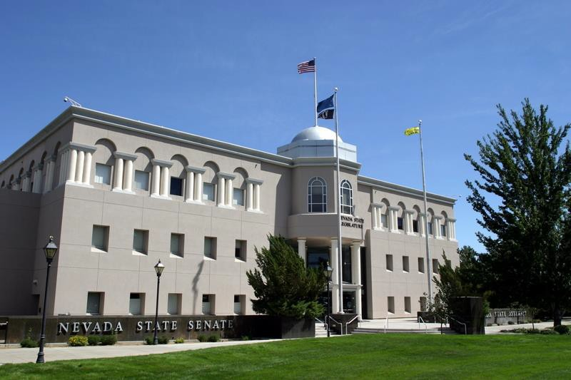
Updates from the 2025
Legislative Session
TEACH A COURSE
12

Slide 13
2025 Updates
Attorney client exception is no longer limited to advice regarding potential or existing litigation.
Physical location requirements for meetings to adjudicate contested cases or consider regulations are clarified in application.
No longer have to read phone number and instructions for public comment when there is a physical location for the meeting.
Clarification that the OML does not provide protection for defamation during public comment.
13

Slide 14

LINKS
https://ag.nv.gov/Hot_Topics/Tr aining_Materials/
https://ag.nv.gov/About/Govern
mental_Affairs/OML_Opinions/
https://ag.nv.gov/uploadedFiles/ agnvgov/Content/About/Gover nmental_Affairs/2019-03- 26_OML_12TH_AGOMANU
AL.pdf
TEACH A COURSE
15

Slide 15

Roberts Rules of Order

Slide 16
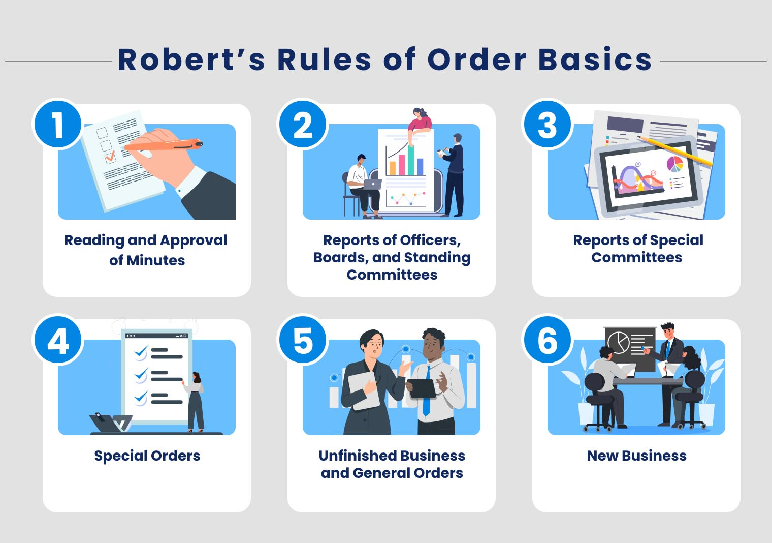
Typical Order of Business
Call to Order
Roll call/determination of quorum
Adoption of agenda
Approval of minutes of previous meeting
Agenda items
Adjournment
*with public comment periods incorporated pursuant to OML

Slide 17
Making a Motion
A motion is a topic under discussion
Any commissioner can introduce a motion when no other motion is on the table
    “I move to . . .”
A motion requires a second to be considered
Each motion must be disposed of (passed, tabled, etc.)
Majority vote required for motion to pass (NRS 383.500: a majority of the members of the Commission is necessary to consider particular business before it and to exercise the power conferred on the Commission)
The language of the motion should be specific

Slide 18
Motion Steps
Motion: A member rises or raises a hand to signal the chairperson.
Second: Another member seconds the motion.
Restate motion: The chairperson restates the motion.
Debate: The members debate the motion.
Vote: The chairperson restates the motion, and then first asks for affirmative votes, and then negative votes.
Announce the vote: The chairperson announces the result of the vote and any instructions.

Slide 19

So, a motion has been made . . .
If you want to change the wording, move to amend by adding or striking words
Or, for significant changes, move to substitute a new motion for the original motion and the Commission will vote on the motion they prefer
Need more time? Move that consideration be deferred (perhaps to after the last agenda item) or move to table the motion to the next meeting

Slide 20
Other possible action
Want to limit discussion? Move to limit debate to a set period of time or set number of speakers. Requires a 2/3 vote.
Want to end discussion? Move to close the debate. Requires a 2/3 vote.
Change your mind on an earlier vote where you were on the winning side? Move to reconsider, and if majority agrees, the motion will come back to the floor as though the vote had not occurred.

Slide 21

Adjournment
If all agenda items have been covered, a motion to adjourn is not necessary but is good practice
If an agenda item wasn’t disposed of, a motion to adjourn is required
Second the motion with majority vote to end meeting

Slide 22
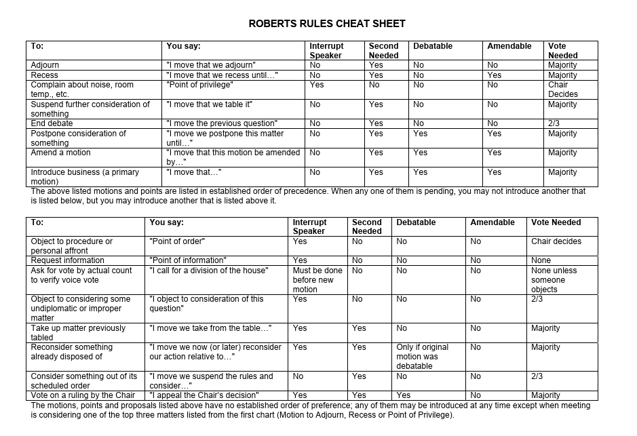

Slide 23
Questions?
Contact info:
aravencroft@ag.nv.gov
(775) 684-1231

